Slide 1




PREDICTING THE NEXT BLOCKBUSTER MOVIE
DSO 510 Project 2 Phase 5
Team: SoTech
Group members: Chun Yang, Deepa Rama Hegde, Jing Wang, Kshitij Kulkarni, Peipei Han, Sheng Ming, Si Lu Liu, Snigdha Goel, Vijaya Lakshmi Tulasi Pali, Xueting Yan, Yu Dong

Slide 2
Our Terrific Website:
http://sotech-imdb.weebly.com/

Slide 3
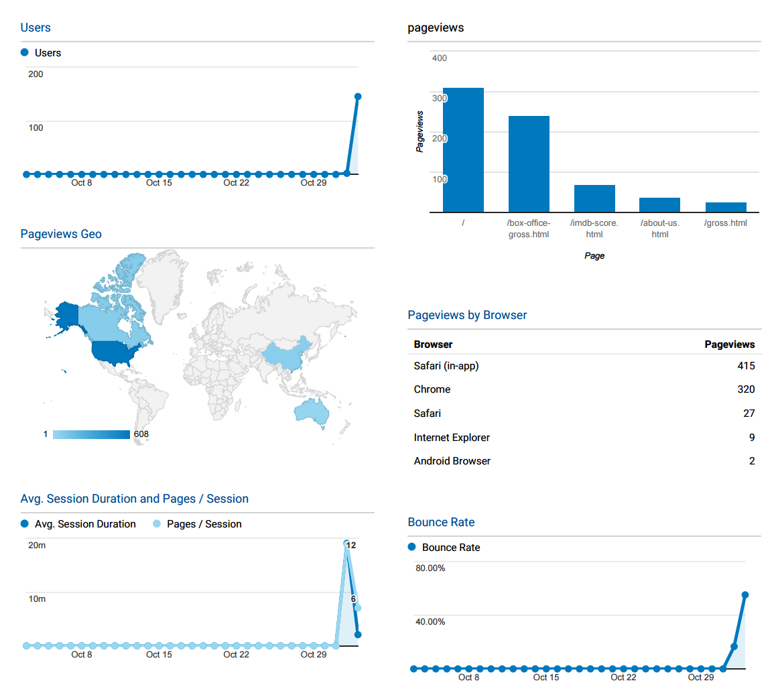
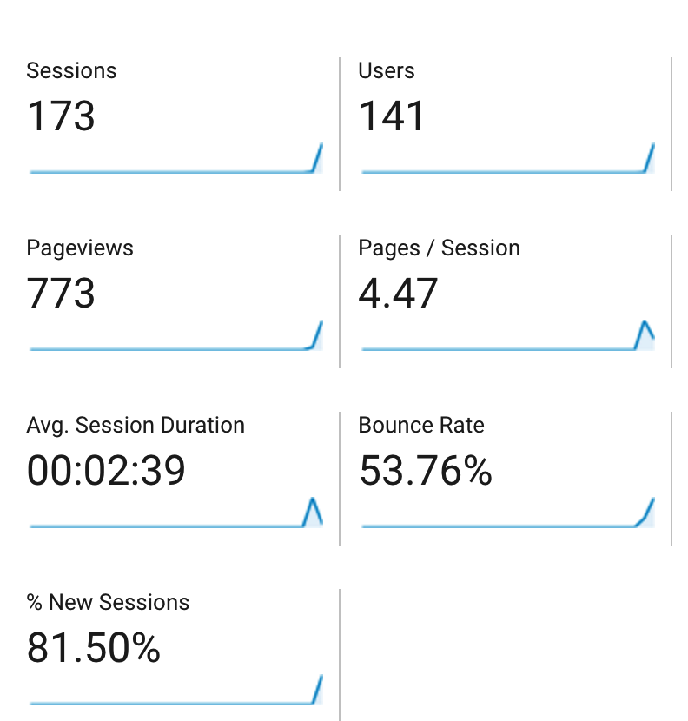
Google Analytics
Updated: 11:00 AM 11/03

Slide 4
GOAL DEFINITION
Business Goal
1) Create a model to predict the success of a new movie before its release in terms of box office gross collection and IMDB rating, on the basis of historic data.
2) Help film executives maximize return on investment and target audience for marketing accordingly by using the essential features like genres and plot keywords.
Notes:
?Success could be defined by 1) box office gross or 2) “classic” that will be tested by time, usually reflected through rating, but might be a box office flop
Box office gross: 1) ranking 2) weekly gross 3) total gross

Slide 5
DATA COLLECTION
Data Sources：
https://www.kaggle.com/deepmatrix/imdb-5000-movie-dataset
A Kaggle dataset of 5000+ movies and 28 related attributes gathered from IMDB
http://www.boxofficemojo.com/alltime/domestic.htm
The Box Office Mojo website mainly provided us with monetary values for movies
http://www.the-numbers.com/movies
Production company for each movie
Rankings of movie gross, production company market share and popularity of each genre and etc.

Slide 6
Variables
Dependent Variable:
IMDB rating
Worldwide gross boxoffice
Calculated Dependent Variable:
IMDB rating level (high/low)
Inflation-adjusted boxoffice

Slide 7
VARIABLE DEFINITIONS
Independent variables classified into 3 categories:
Movie attribute variables include:
Categorical: country, language, content rating, Booleans variables of popular genres, Booleans variables of top 6 production company
Numerical: movie duration
Social media related variables include:
Categorical: names of director and actor
Numerical: number of reviews from critics and users, number of voted users, facebook likes, face number on poster
Production related variables include:
Categorical: release date, release season, release year
Numerical: production budget, inflation adjusted production budget, ROI
* red: calculated variables

Slide 8
IMDB Score Analysis

Slide 9
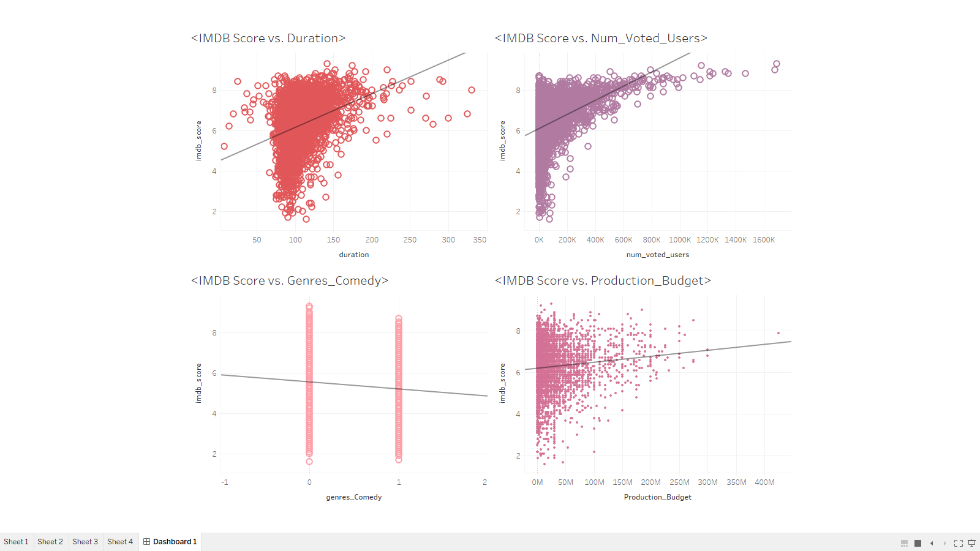
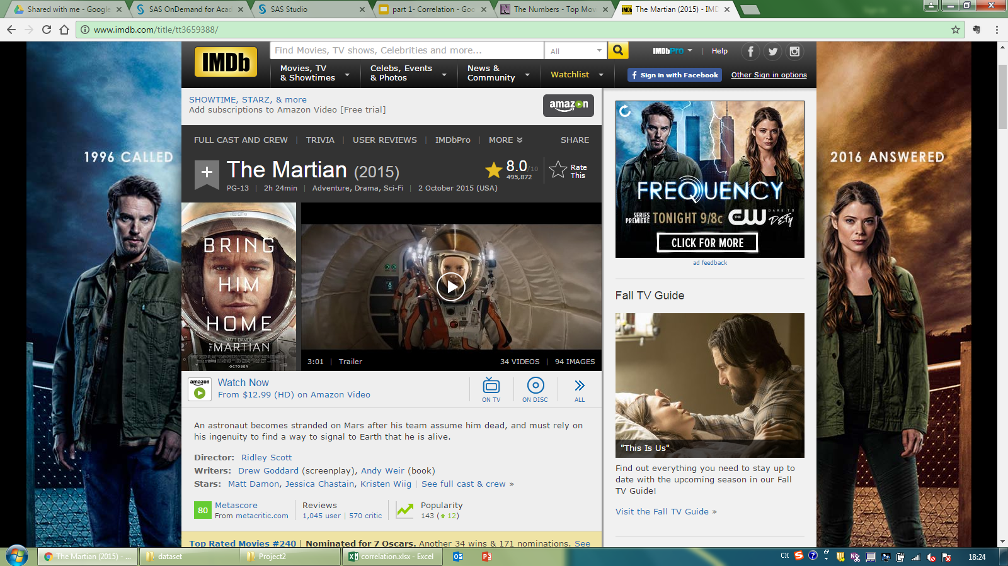
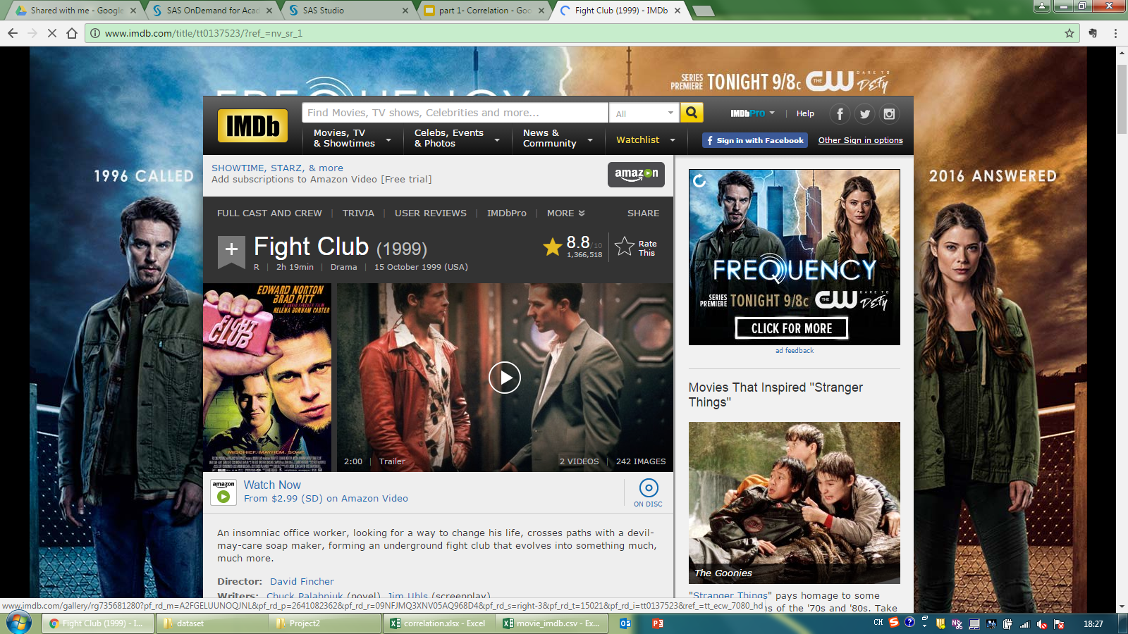
CORRELATION
IMDB Score ~ Independent Variables
Notes:
Seemingly strong relationship with duration, number of voted users

Slide 10
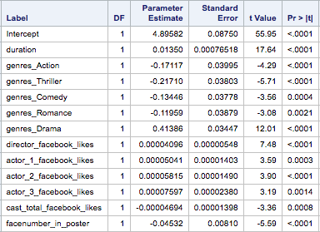
LINEAR REGRESSION IMDB Rating
Duration, Facebook Likes
Face number in poster
Inflation adjusted Budget
Genre Drama Thrillers
Production Company Walt Disney Non-top 6
Season Fall Winter
Adjusted R-square: 0.2436
Regression Model:
IMDB score = 4.90 + 0.01 duration – 0.17 Action – 0.22 Thriller – 0.13 Comedy – 0.12 Romance + 0.41 Drama + 0.00004 director_facebook_likes + 0.00005 * actor1_fb_likes + 0.00006 * actor2_fb_likes + 0.00008 * actor3_fb_likes – 0.00005 cast_total_fb_likes – 0.05 * facenumber_in_poster
Top 6 Production Companies:
1.Warner Bros 2.Walt Disney
3.Sony Pictures 4.20th Century Fox
5.Universal 6.Paramount Pictures

Slide 11
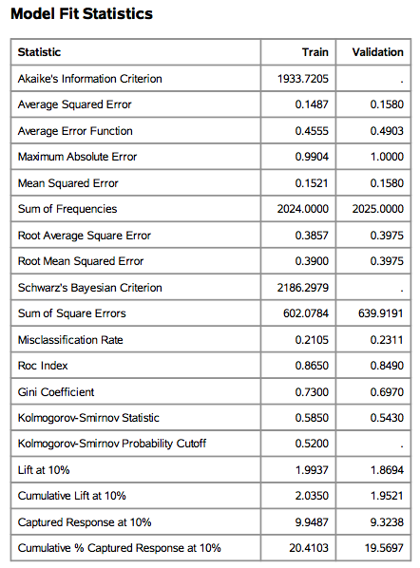
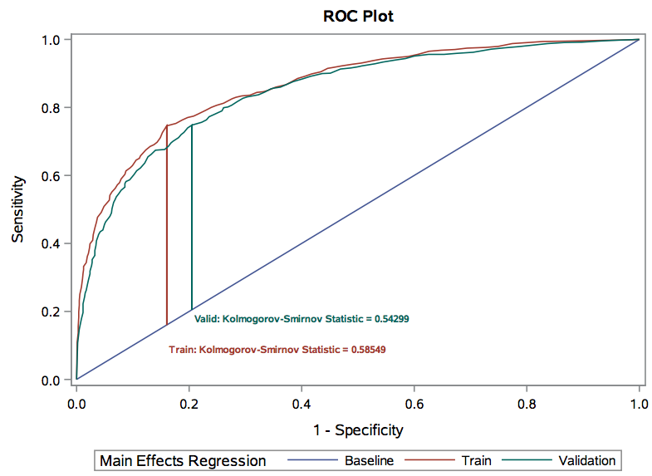
ROC Curve

Slide 12

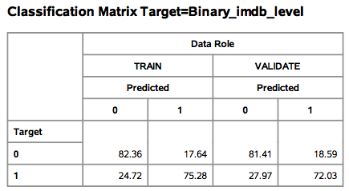

RPM

Slide 13
Worldwide Gross Boxoffice Analysis

Slide 14
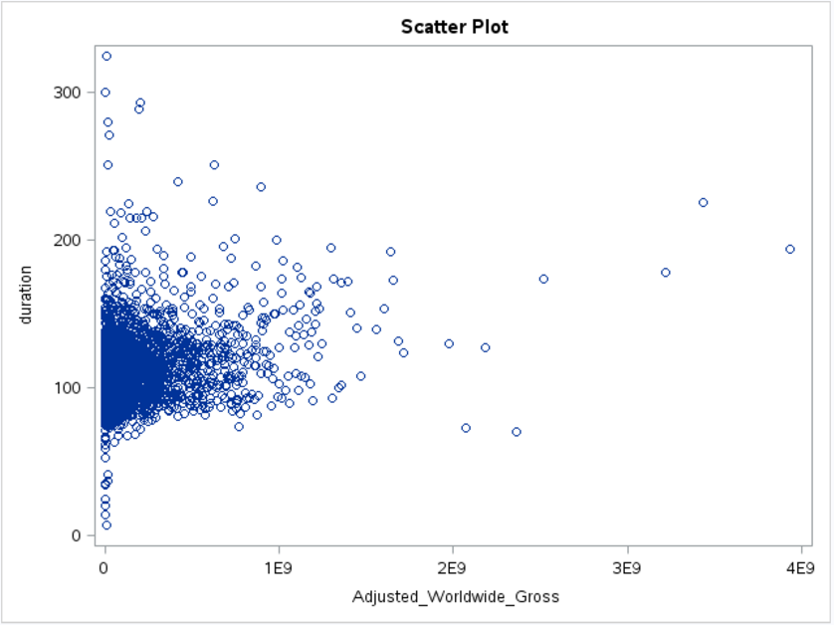
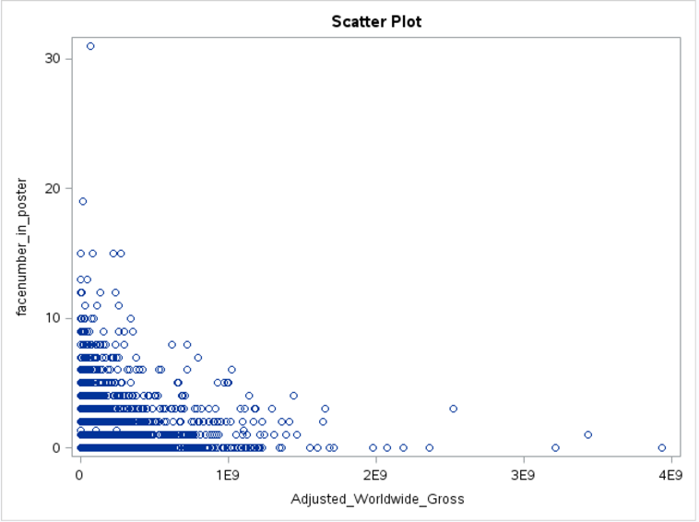
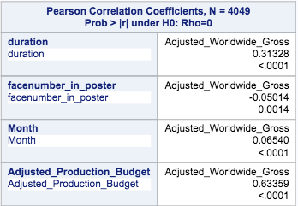
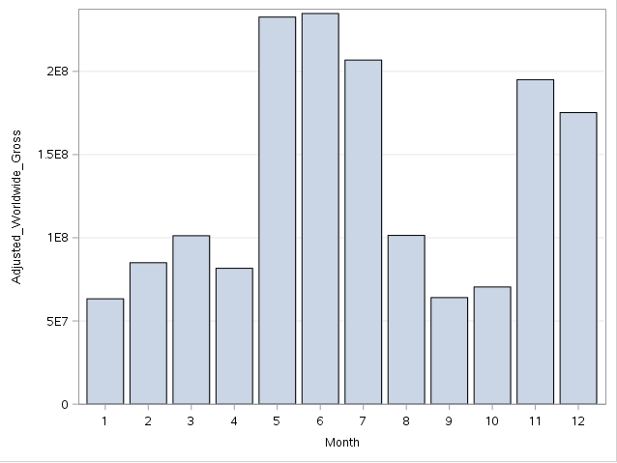
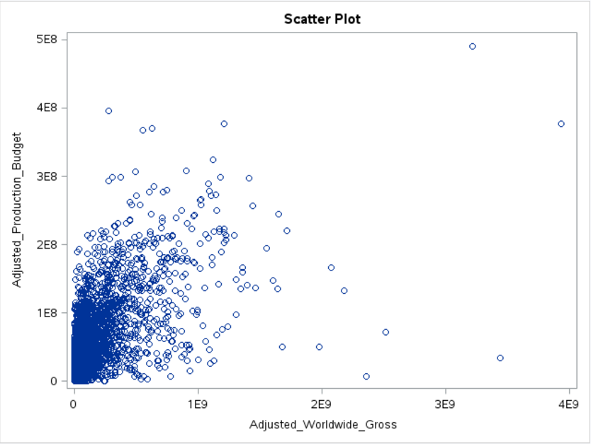
CORRELATION
Adjusted Worldwide Gross ~ Duration/Budget/FaceNum/Released Month
Duration: A length of 80 to 150 minutes is ideal
Released Month: Summer attracts more people
Budget is especially stronger correlated to gross: Generally, the more you invest, more people will be attracted and go to see the movie!

Slide 15
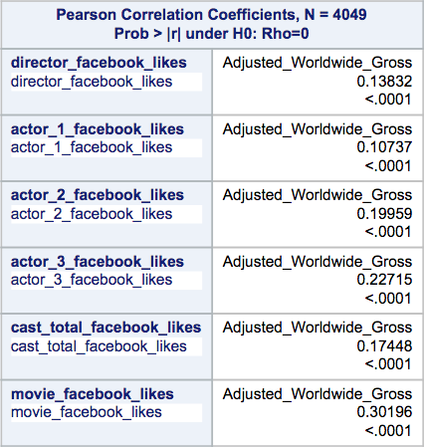
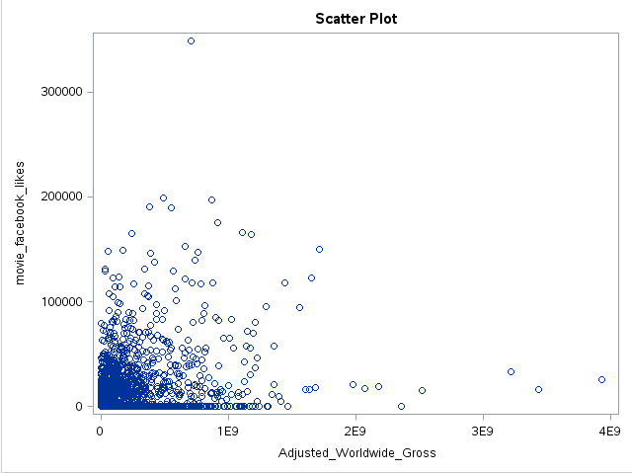
CORRELATION
Adjusted Worldwide Gross ~ Facebook Likes
All positive related, however, Movie FB likes has the most strong correlation with gross- Rather than choosing the most hot-topic actors/directors, enough promotions and marketing of movie itself on Social Media is most crucial!

Slide 16
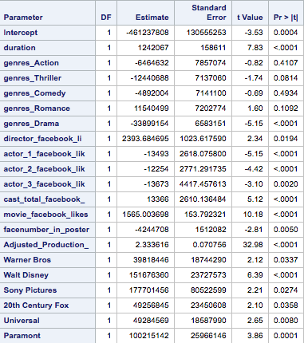
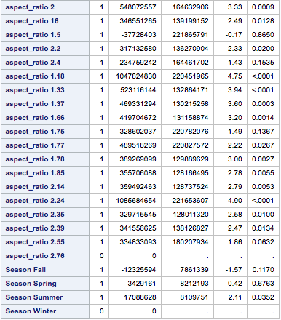
LINEAR REGRESSION INFLATION ADJUSTED WORLDWIDE GROSS
Duration
Director/Cast Facebook likes
Adjusted Budget
Actor Facebook likes
Face number in poster
Country, Language, Content rating
Genre Romance Thrillers
Production Company Sony Pictures Non-top 6
Season Summer Fall
Adjusted R-square: 0.4530
Gross Box office = - -461237808 +duration * 1242067+genres_Romance * 11540499 -genres_action * 6464632-genres_Thriller*12445688-genres_comedy* 4892004 –genres_Drama* 33899154 +director_fb_likes *2303.7-actor_1_fb_likes*13493-actor_2_fb_likes*12254-actor_3_fb_likes*13673+ cast_total_fb_likes*13366+ movie_fb_likes*1565-facenumber_in_poster*4244708+Adjusted_production_budget*2.33+Warner Bros*30818446+Walt disney*151676360+Sony Pictures * 177701456+20th Century Fox * 49256845+Universal* 49284569+Paramount* 100215142-Season_Fall* 12325594+Season_Spring* 3429161+Season_Summer* 17088628

Slide 17
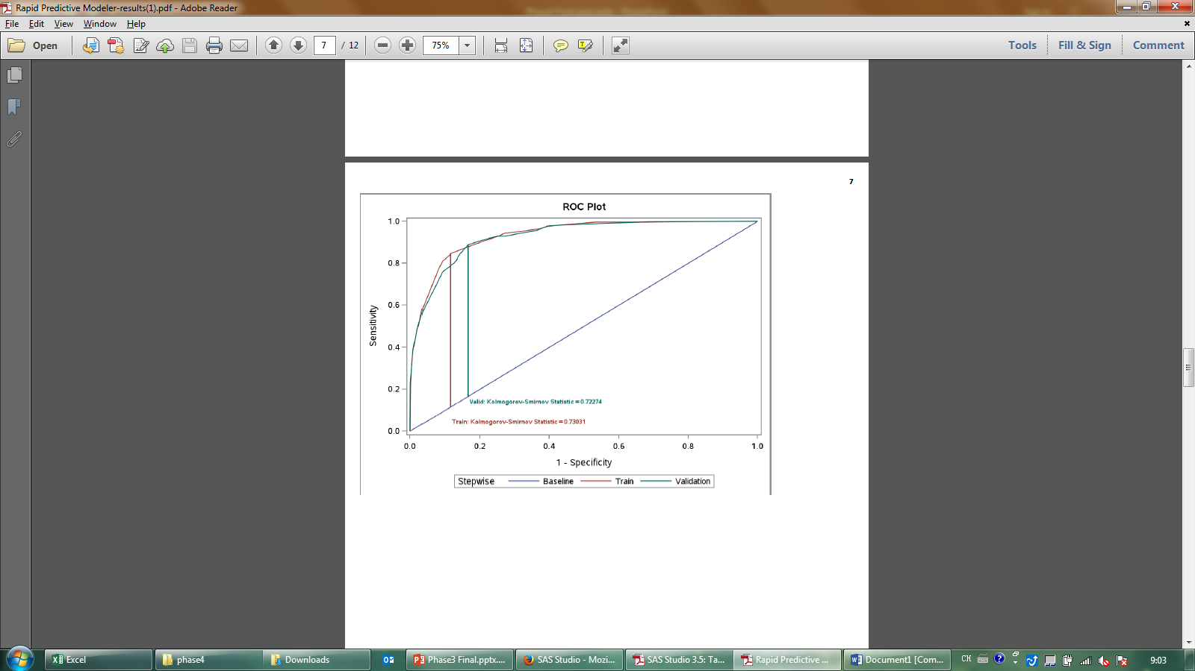
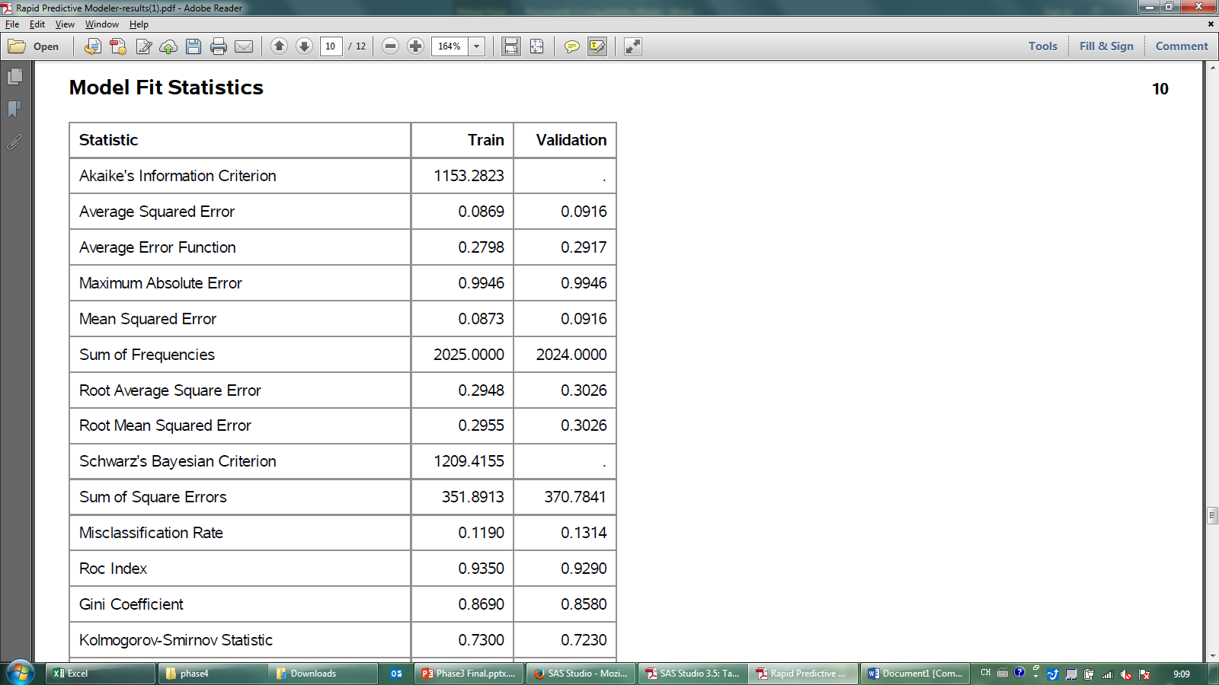
ROC Curve

Slide 18

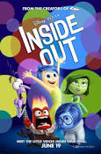
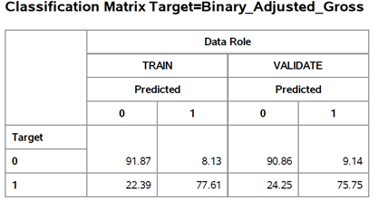
RPM

Slide 19
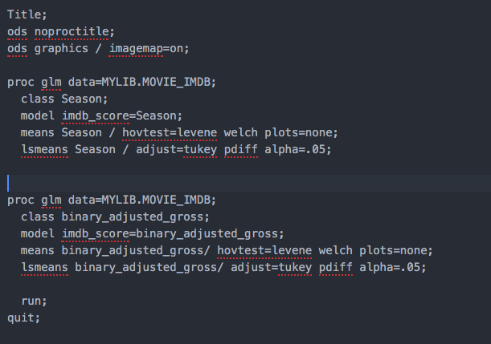
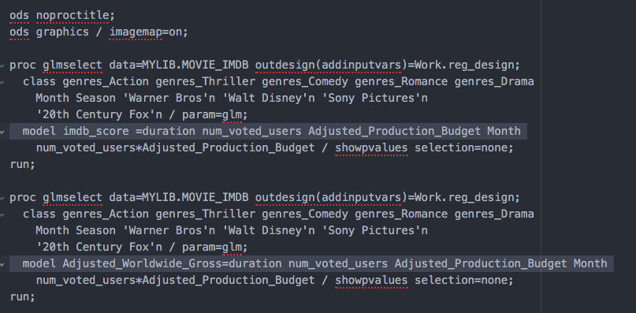
SAS Macro Programs
IMDB ANOVA
IMDB Linear Regression

Slide 20
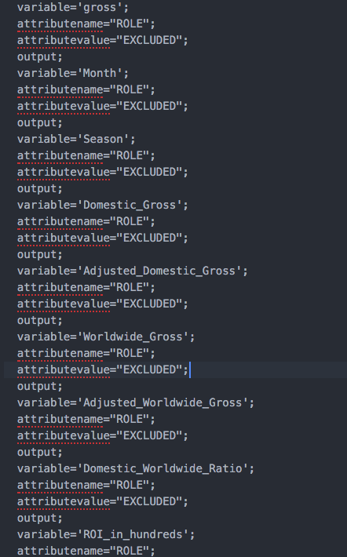
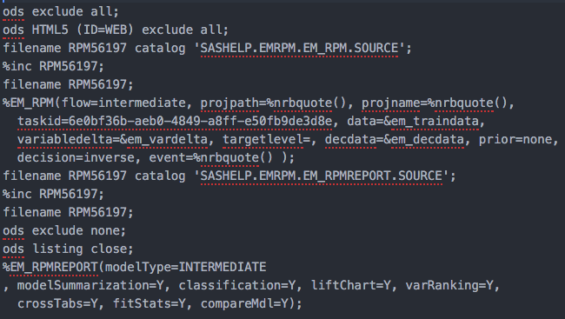
IMDB Score RPM
IMDB Gross RPM

Slide 21
Recommendations
If you want a high IMDB score
Longer duration, popular directors and actors, fewer faces in the poster
Budget doesn’t have much impact on the score
Make a Drama and release in Fall!
Get Walt Disney to produce your movie
If you want a high gross boxoffice
Medium duration, popular directors, fewer faces in the poster
Do spend more budget
Make a Romantic movie and release in Summer!
Get Sony Pictures to produce your movie
Notes:
Recommendations

Slide 22
-THE END-
Thank you!

